Slide 1
Innovations in Cultural Competency: Seeking Justice, Building Capacity
Alliance for Nonprofit Management
Annual Conference 2013
Session Leaders:
Elsa A. Rios, J.D., M.S.W.
Brigette Rouson, J.D., M.A.

Slide 2
Overview
Introductions and Learning Agenda
Overview of RoadMap
Capacity Building Considerations for Social Justice Organizations
Small Group Discussion
Recap of Key Points

Slide 3
Learning Objectives
Offer a cultural competency frame to understand and better serve social justice organizations
Distinguish key characteristics of social justice organizations and implications for capacity bldg.
Introduce practical tools for strengthening social justice organizations and alliances

Slide 4
A Dialogue With You…
Think of a social justice organization you have worked with, what was most inspiring and different about them?
What challenges you most about working with social justice groups?

Slide 5
About RoadMap
Misson: To strengthen the social justice sector
through capacity building.
Key Goal: To fuel better organizational and
movement performance and sustainability.
Composition: A national network of 16 Core and 45 Affiliate consultants, progeny of FACT and having served 70 social justice groups and more than 100 consulting projects.
Approach: Intensive capacity building, learning lab projects to advance the field and coaching for social justice leaders.

Slide 6
LEARNING LAB PROGRAM
Advancing knowledge about what is working and why…
LEARNING LAB
NEW TOOLS AND MONOGRAPHS
PEER EXCHANGE AMONG SJ GROUPS
MAPPING PROJECT
INTERMEDIARY LEARNING PARTNERSHIPS
E-LEARNING

Slide 7


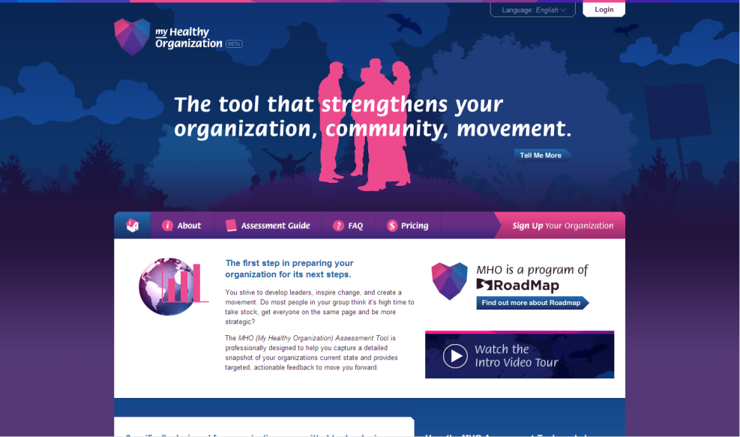

MHO: Supporting Assessment, Reflection and Learning for Action
Specifically designed for social justice organizations
Easy online tool administered to 300 plus organizations
Alignment and divergence scale
Available in Spanish
Opportunity for organization-wide
dialogue and learning
myhealthyorganization.org

Slide 8
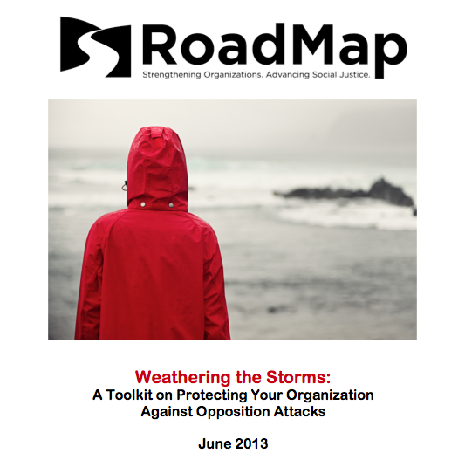

Slide 9
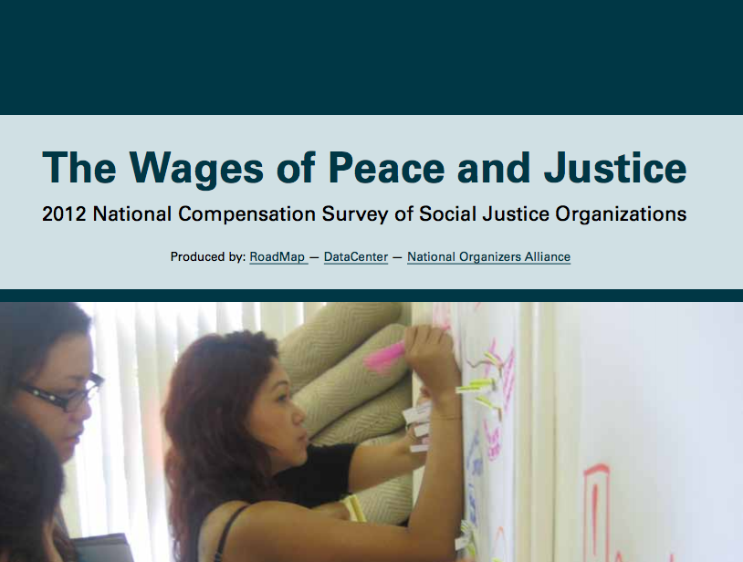

Slide 10
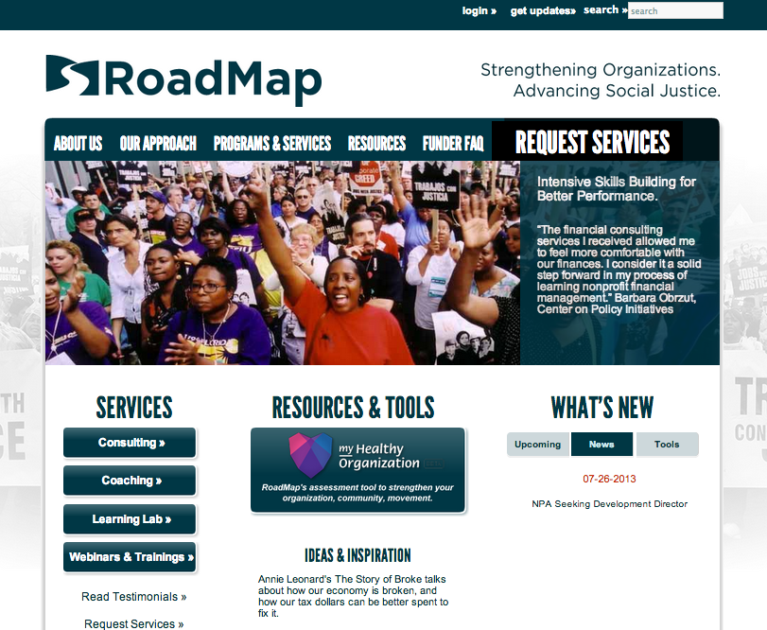

Slide 11
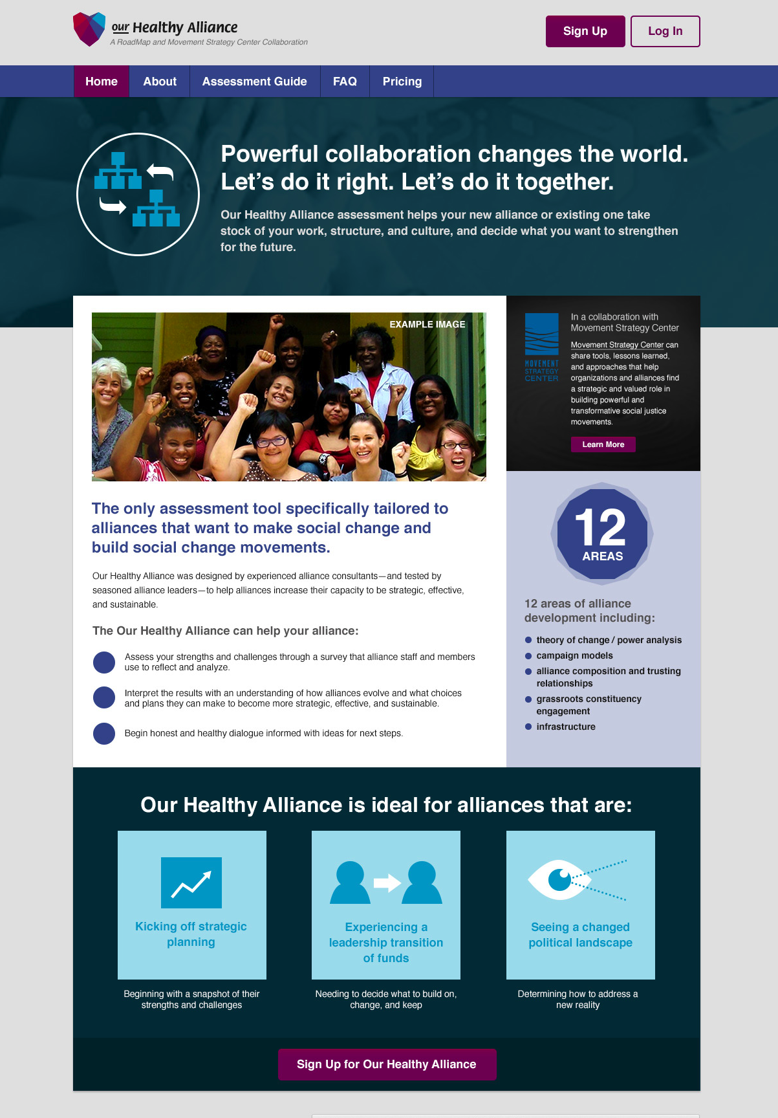

Slide 12
What is Our Healthy Alliance Assessment?
Specifically designed for alliances of social justice organizations with a movement building approach.
Focused on alliances with a shared political goal, greater than a service coordination, learning community or information-sharing network.
Assesses 12 Areas of Alliance performance.
Easy online tool, unlimited number of participants.
Report with Charts, Alignment and Divergence scale.
Facilitated Interpretation of the Findings.

Slide 13
Overview of OHA Categories
Section I: Purpose: Mission Vision & Values
“We know who we are, our purpose, and what binds us together.”
II. Theory of Change/Power Analysis
“We have an analysis of the systems we are seeking to influence and how our alliance’s role fits into a larger social change strategy.”
III. Campaign Models
“We know there are different approaches for what we want to win. We have researched and chosen the strategies & models that makes the most sense for us.”
IV. Alliance Composition and Trusting Relationships
“We have the right mix of people and deep trust in our alliance to build our capacity and our power.”
V. Alliance Planning and Impact Evaluation
“The Alliance knows what impacts we want to have, and our priorities and metrics are aligned towards those outcomes.”
VI. Grassroots Constituency Engagement
“We are deeply rooted in our community and pro-actively engage and promote grassroots leadership.”

Slide 14
Overview of OHA Categories
VII. Strategic Communications Capacity
“We frame the debate.”
Structures and Practices for Alliance Leadership
“We have clear and dynamic structures and practices to function honestly and effectively.”
IX. Functioning of the Alliance Leadership Body
“Our leaders step up AND support others.”
X. Alliance Culture and Relationships
“We are committed to cultural diversity and creating a reflective, respectful
culture within the alliance.”
XI. People: Alliance Staff
“Our team is strong and we treat our people right.”
XII. Infrastructure: Funding, Finances, Personnel and Technology
“We have adequate funding and infrastructure that keep things running smoothly.”

Slide 15




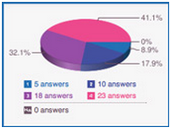
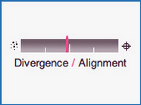
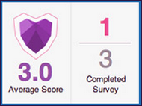
OHA Levels and Features
 | Understanding Our Healthy Alliance “LEVELS” |  | FOR EACH CATEGORY participants choose a description of their current practice
 | Level 1 = Have basic or limited capacity in this category. Very focused, and/or somewhat defensive stance. |  | Level 2 = Have core practices in place. But are somewhat inconsistent or not widely understood across the alliance. |  | Level 3 = Substantial capacity in this area, and key indicators are understood and practiced at the core leadership. Proactive and improving |  | Level 4 = Highest level of clarity, transparency and consistency throughout the alliance and member groups. Thorough & Strategic

Slide 16
OHA Sample Questions
The following question assesses the how the alliance does deeply analysis of the wider political cultural context, and how widely it embeds political education throughout the alliance member groups.
 | Level One |  | Level Two |  | Level Three |  | Level Four
 | Political Analysis. We pay attention to external trends that affect our core issues. We collect and share policy updates on issues where we have active campaigns. |  | We educate alliance leadership on analysis of the external political terrain and social-cultural context that affects our issue areas. We have an established curriculum to train selected staff in effective organizing and advocacy, including political analysis on our core issues. |  | We regularly analyze the political-cultural terrain to pro-actively assess opportunities for our campaigns. Our political education program reaches a significant number of staff and grassroots leaders of the alliance’s member groups. |  | We use a dynamic, approach to feed political analysis back into our strategies and to refine or shift our mission. The whole alliance is prepared to use political analysis to take advantage of opportunities that arise, and quickly respond to changing conditions.

Slide 17
Definitions of Key Terms

Slide 18
What do we mean by the term culture?
Culture refers to integrated patterns of human behavior encompassing values, beliefs, customs, practices, languages, methods of communicating and interacting within and across cultural groups. It is common history, experiences, geography, social norms, lifestyles and artistic forms transmitted from generation to generation.
Culture is multidimensional, dynamic and contextual.
Efforts to understand the experiences of cultural groups and address their needs should also incorporate a power and impact analysis.

Slide 19
Cultural Competency
“Cultural competence is a set of behaviors, attributes and policies enabling an agency (or individual) to work effectively in cross cultural situation.” Minority Executive Directors Coalition
Cultural competence requires that organizations and their personnel have the capacity to:
Value diversity;
Conduct self assessment;
Manage the dynamics of difference;
Acquire and institutionalize cultural knowledge; and
Adapt to the diversity and cultural contexts of individuals and community served
National Center for Cultural Competence

Slide 20

A community-centered process that begins with an understanding of historical realities and an appreciation of the community’s assets in its own cultural context. The capacity building process should enhance the quality of life, create equal access to necessary resources, and foster strategic and progressive social change resulting in a just society.
- Alliance People of Color Affinity Group, Cultural Competency Initiative
Culturally Competent
Capacity Building

Slide 21
Why Focus on Social Justice Organizations?
How are they any different?
Complexity
Location in the Eco System
Distinct Challenges & Advantages
Potential for Transformative Change
Why use a cultural competency lens?
Distinct culture/norms/values
Embrace cultural pluralism
Use an intersectional approach
Tend to want to reflect/live their values in their organizational systems – e.g., power shifting

Slide 22
Distinguishing Social Justice Organizations
Core mission committing to transformational, systemic change that addresses power imbalances and structural inequities
Understanding of being part of a larger social change eco-system, investing major resources in becoming movement building organizations

Slide 23
Common Characteristics
Tougher fundraising challenges: Only 2% of grants go to social justice organizations
Dual focus on organization and movement building can be very taxing on resources
Less focus on “professionalism,” more on grassroots leadership development
More questioning of hierarchy and “management” concepts from business
Open to experimentation; fewer documented organizational best practices

Slide 24
Intersectionality: The Impact of Multiple Oppression
Intersection of Oppressions
Sexism
Homophobia
Xenophobia & Nativism
Poverty
Ablelism
Ethnic and Racial Discrimination

Slide 25
Common Characteristics
Cultural Pluralism
Human Rights
Anti-Racism
Social Justice Framework

Slide 26
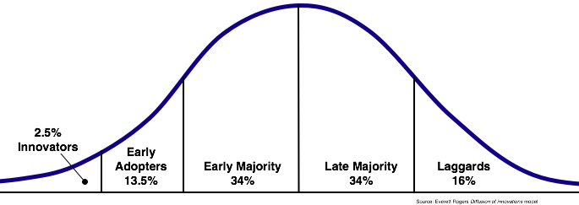
Distinguishing Social Justice Organizations
Innovators and Early Adopters

Slide 27
Eco Placement
Role and function in larger social change efforts
Anchor organization’s responsibilities
Resource allocation issues
Decision-Making
Deliberative
Decentralized
Consensus oriented
Fluid/shared
Need for increased information sharing and communication
Values
Democratic
Inclusive
Transparent
Pioneering new organizational practices that match values
Characteristics & Challenges of Social Justice Organizations
Governance & Accountability
Greater community accountability
Preparing grassroots leaders for governance
Culture
Experimental
Risk-taking
Adaptive
Questioning
Measuring Impact
Distinguishing collective and organizational successes
Challenges regarding quantifying impact
Leadership
Priority area for investments
Focus on persons with lived experiences
Less professional-centric
Leadership development at all levels

Slide 28
Elements of Organizational Life
Through a Cultural Lens
Practices
Policies
Structures
Attitudes
Behaviors

Slide 29
Key Concepts and Findings: Mainstream vs. Culturally Competent Practice
MAINSTREAM | CULTURALLY COMPETENT
Cultural difference – only relevant at some points in time, in some situations, where surfaces in very obvious way, crisis-driven | Culture is woven throughout the encounter – always attentive to dynamics
Feeding into system that disadvantages certain people, privileges others | Challenges system, takes account of inequities and seeks to change power relations; deeper analysis that deals with phenomena such as internalized oppression and institutional /structural racism
Can take people out of their cultural base – purports to be identity-neutral and value-neutral | Can invite people to do the work by offering shared background or appropriate storytelling Source: Alliance CCI research

Slide 30
MAINSTREAM | CULTURALLY COMPETENT
“Hard” skills valued and seen as separate from culture – e.g., fiscal management, fundraising, governance | “Soft” skills valued as an essential part of capacity building–human relations, stakeholder engagement, conflict resolution. Both “hard” and “soft” skills need to be seen through lens of culture.
Revolving door and exclusion of diverse staff | Recruiting, retaining, developing diverse staff
Believes that in order to maintain diversity, people of color need to be “developed” | Recognizes that people of color bring skills and strengths to the organization, and that the organization needs to be “developed” in order to appreciate the range of talents and approaches.

Slide 31
Group Exercise
Volunteers: 3 – 4
Bring an example of a challenge faced by a social justice group
  Leadership transition
  Conflict in an alliance
  Conflict among constituents
  Fundraising challenges
  Setting a new strategic direction
Building on the collective wisdom: In break out groups, use the guiding questions to come up with strategies/approaches to capacity building (Next slide)

Slide 32
Group Exercise
GUIDING QUESTIONS:
Using the frame we have presented and our group discussion, what new questions might you ask as part of your assessment process?
What factors might you pay greater attention to and how might you design engagements differently as a result?
A few considerations:
intersectional analysis/approach
approach to power sharing
accountability to constituencies
shared decision making
leadership development practices
cultural history and cross cultural understanding; and
organizational practices that reflect their norms and values
Reflection to Action: What can you do to advance your practice based on the insights gained through our group discussion?

Slide 33
On the Road to Social Transformation
S
Cultr
Social Justice/
Social Change Work
PLUS
Culturally
Competent
Capacity Building
Facilitates Social Transformation!

Slide 34
RESOURCES
More Info:
www.roadmapconsulting.org
michelle@roadmapconsulting.org

Slide 35
SELECTED RESOURCES
BOOK
MONOGRAPHS
& MORE
Embracing Cultural Competency:
A Roadmap for Nonprofit Capacity Builders, by St.Onge, Applegate, Asakura, Moss, Rouson, and Vergara-Lobo
- Alliance for Nonprofit Management and
Fieldstone Alliance (2009)
Cultural Competency in Nonprofit Capacity Building,
by Satterwhite, Teng, and Fernandopulle
Multicultural Organizational Development,
by Mayeno
- CompassPoint and California Endowment (2007)
Technical Assistance and Progressive Organizations for Social Change in Communities of Color, by Guerra (1998) http://comm-org.wisc.edu/papers99/guerra.htm
Capacity Building Work with Social Justice Organizations, by Philbin (1996)
RESOURCE BANK: Roadmapconsulting.org

Slide 36
Key Concepts and Findings:
Defining Characteristics of Culturally Competent Capacity Building
  Social change as motivating force
  Active exploration of cultural bases including gender, generation, geography, historical context, religion, sexuality, socioeconomic background
  Sharing and building power
  Modeling and facilitating learning
  Breaking silence
  Building principled relationships
  Structuring work with a cultural lens
  Source: Alliance for Nonprofit Management (CCI research)

Slide 37
Internalized Superiority
Institutional Racism
Power & Privilege
Ethnocentrism
Internalized Superiority
Structural Racism

Slide 38
Internalized Oppression
Institutional Racism
Discrimination/Intersection of Oppression
Negation and Invisibility
Internalized Oppression
Structural Racism

