Slide 1
ROADMAP
A NATIONAL CAPACITY BUILDING PROGRAM
DESIGNED FOR SOCIAL JUSTICE ORGANIZATIONS
Quality
Praxis
Experience
A six year track record of serving social justice organizations. Over 60 capacity building engagements and superior evaluation ratings.
A progressive learning community that seeks to advance praxis through peer exchange and developing capacity building infrastructure within social justice groups.
A national network of 16 seasoned capacity builders plus affiliate consultants and experts organized in regional hubs.

Slide 2
1
OUR HISTORY
The Legacy of the French American Charitable Trust
ROADMAP is the progeny of the Management Assistance Program (MAP) of the French American Charitable Trust (FACT). Over a period of 6 years MAP conducted over 63 intensive engagements with 28 social justice organizations and received highly favorable evaluation ratings.
As FACT prepared to spend down, social justice organizations and funders alike expressed the need to continue MAP in some way. After a feasibility study confirmed the need for a capacity building program for social justice organizations, seed funding from FACT and the Unitarian Universalist Veatch Program at Shelter Rock helped to launch ROADMAP.
Our mission is to strengthen the social justice sector through capacity building.
We are a national social change capacity building program developing new strategies, articulating promising 21st century organizational development practices, and widely disseminating those findings and tools. Our goal is to fuel better organizational and movement performance and sustainability.
For MAP case studies see: http://www.factservices.org/case_study.html
For More Information Contact Our Team Co-Leaders:
Emily Goldfarb: egoldnrio@aol.com
Elsa A. Ríos: elsa@strategiesforsocialchange.com
\
ROADMAP
CAPACITY BUILDING FOR SOCIAL JUSTICE

Slide 3
2
WHAT MAKES US DIFFERENT?
A One Stop Shop for Capacity Building
Our national capacity building program is specifically designed for social justice organizations.
We are a diverse, multi-lingual and vetted group of 16 core consultants with past experience leading or working at senior levels within social justice organizations.
We operate as a lean and nimble network of capacity builders without incurring the typical bricks and mortar costs associated with nonprofits. Cost savings are reinvested in field building projects.
4. We provide deeper capacity building engagements of 12-18 months allowing for more sustainable results.
5. Our approach enables funders to design a customized capacity building (CB) program for their grantees without having to create an in-house CB program.
6. We use a skills transfer and integration approach to ensure that staff enhance their skills and new practices take root in each organization before we leave.
ROADMAP
CAPACITY BUILDING FOR SOCIAL JUSTICE

Slide 4
3
WHAT MAKES US DIFFERENT?
A One Stop Shop for Capacity Building
7. We are organized in regional hubs and use affiliate consultants and strategic partners to provide a range of expertise and meet the demand for cost-effective services.
8. We offer customized services and tools that fit the ethos, culture, leadership styles and decision-making processes of social justice organizations and alliances.
9. We promote social movement development and field building through peer exchange programs and our own learning laboratory programs.
10. We engage in joint planning & collaborative projects with key intermediaries in order to maximize resources and achieve greater impact.
ROADMAP
CAPACITY BUILDING FOR SOCIAL JUSTICE

Slide 5
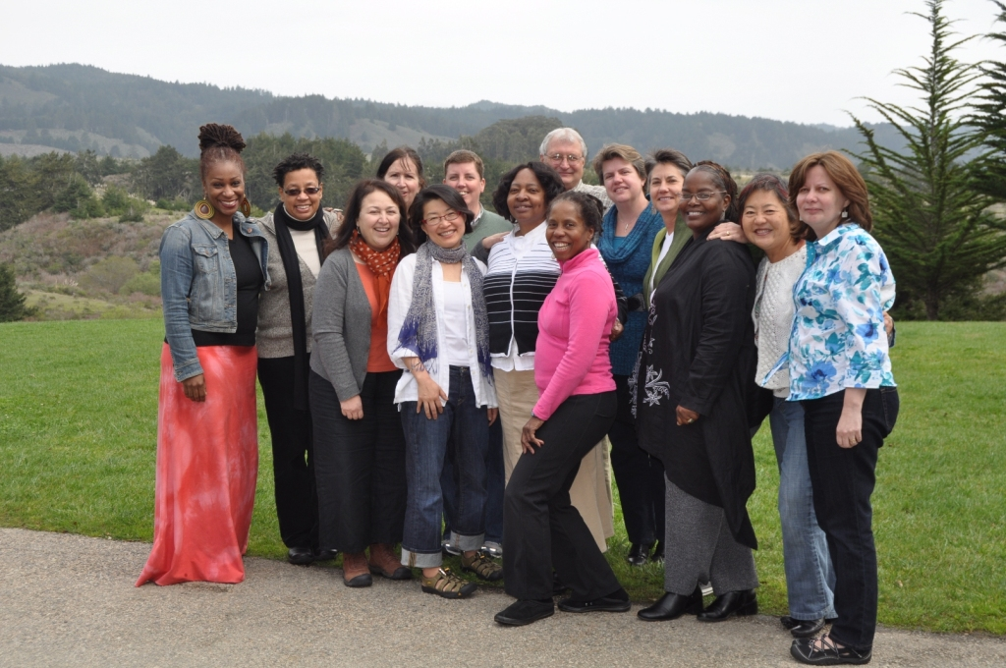
4
MEET OUR TEAM
ROADMAP
CAPACITY BUILDING FOR SOCIAL JUSTICE

Slide 6
5
GUIDING PRINCIPLES
We believe in the transformative impact social change organizations have upon our society and support organizations to …
Support the leadership of individuals with lived experiences, fully embracing their insight and depth of knowledge.
Embrace a spirit of experimentation, risk-taking and innovation necessary to creating a new and better world.
Develop transparent and democratic institutions grounded in human rights and anti-oppression principles.
Promote healthy, sustainable organizational practices including building leadership at all levels.
Recognize the importance of nurturing the mind, body and spirit as a way of sustaining healthy organizations and movements.
Maintain high standards of accountability to the constituents and/or communities they serve.
ROADMAP
CAPACITY BUILDING FOR SOCIAL JUSTICE

Slide 7
6
AUDIENCES & STRATEGIES
We work with foundations and funder collaborative groups to strengthen the capacity of grantees:
We offer funders the ability to offer in-depth capacity building services to their grantees without the high cost and staffing time required to develop an in-house program.
Our wrap around services include assessment, program design, implementation, quality assurance and evaluation.
Our assessment tool, My Healthy Organization, provides an overall picture of grantee needs enabling funders to support customized capacity building.
Our mapping project enables funders to identify grantees in common and pool resources to support capacity building.
Our field building approach promotes regular peer to peer learning exchanges among social justice groups, thereby providing greater return on investment.
We provide added value services such as supplemental e-learning activities to continually build grantee capacity.
Note: We define social change as the process by which people through participation in social movements work to create a more just and sustainable world.
ROADMAP
CAPACITY BUILDING FOR SOCIAL JUSTICE

Slide 8
7
AUDIENCES & STRATEGIES
We work with organizing and policy groups advocating for progressive social, racial, economic and environmental justice with particular emphasis on:
Community-based and membership organizations which organize communities of color and low income communities.
Undeserved geographic areas or groups that lack access to capacity building.
Movement building oriented organizations which link their goals with other issues and sectors through shared political analysis and strategic alliances.
Sectors where capacity building can accelerate movement building by helping organizations get to scale, increase impact and build power.
Alliances, networks and coalitions where capacity building services not only benefit multiple social change groups in relationship to each other but also contribute to large scale impact.
Moments of opportunity where capacity building can help alliances to better position themselves to win major precedents or victories.
ROADMAP
CAPACITY BUILDING FOR SOCIAL JUSTICE

Slide 9
8
INTEGRATED SERVICES
Providing a continuum of integrated services ...
Assessment Tools
Capacity Building
E-Learning
2011: My Healthy Organization
An online organizational assessment tool designed for social justice organizations. Optional consultation is available to help organizations address MHO findings. A Spanish language version is due out in just a few months.
2012: My Healthy Alliance
(projected date of launch)
Strategic Planning
Program Development
Financial Assessment
Grassroots Fundraising
Donor Campaigns
Board Development
Strategic Communications
Leadership Transitions
Leadership Coaching
Team Building
Human Resources
Evaluation
Strategic Restructuring
Guidance on c(3) and c(4)
Webinar Plus Series
coupled with technical assistance consultation on:
1. Financial Management
2. Grassroots Fundraising
3. Major Donor Development
4. Leadership Transitions
Peer to Peer Exchange
Resource Library
Monographs
Case Studies
ROADMAP
CAPACITY BUILDING FOR SOCIAL JUSTICE

Slide 10
13
LEARNING LAB PROGRAM
Advancing knowledge about what is working and why…
LEARNING LAB
NEW TOOLS AND MONOGRAPHS
PEER EXCHANGE AMONG SJ GROUPS
MAPPING PROJECT
INTERMEDIARY LEARNING PARTNERSHIPS
E-LEARNING
ROADMAP
CAPACITY BUILDING FOR SOCIAL JUSTICE

Slide 11
ROADMAP
For more information please contact our
Team Co-leaders:
Emily Goldfarb (West Coast)
T.415-566-5480
Egoldnrio@aol.com
Elsa A. Ríos (East Coast)
T. 212-785-0544
Elsa@strategiesforsocialchange.com
Quality
Praxis
Experience
A six year track record of serving social justice organizations. Over 60 capacity building engagements and superior evaluation ratings.
A progressive learning community that seeks to advance praxis through peer exchanges and developing capacity building infrastructure within social justice groups.
A national network of 16 seasoned capacity builders plus affiliate consultants and experts organized in regional hubs.

